Slide 1
ISP: Image sensor Processor
FPT training (1)
Marie-Anne Le Menn ADAS application engineer
30, August 2016

Slide 2
AGENDA
The purpose of the ISP
Its architecture
How to program it

Slide 3
AGENDA
The purpose of the ISP
S32V234 vision applications
Image sensor processing
Image pipeline
Its architecture
How to program it

Slide 4
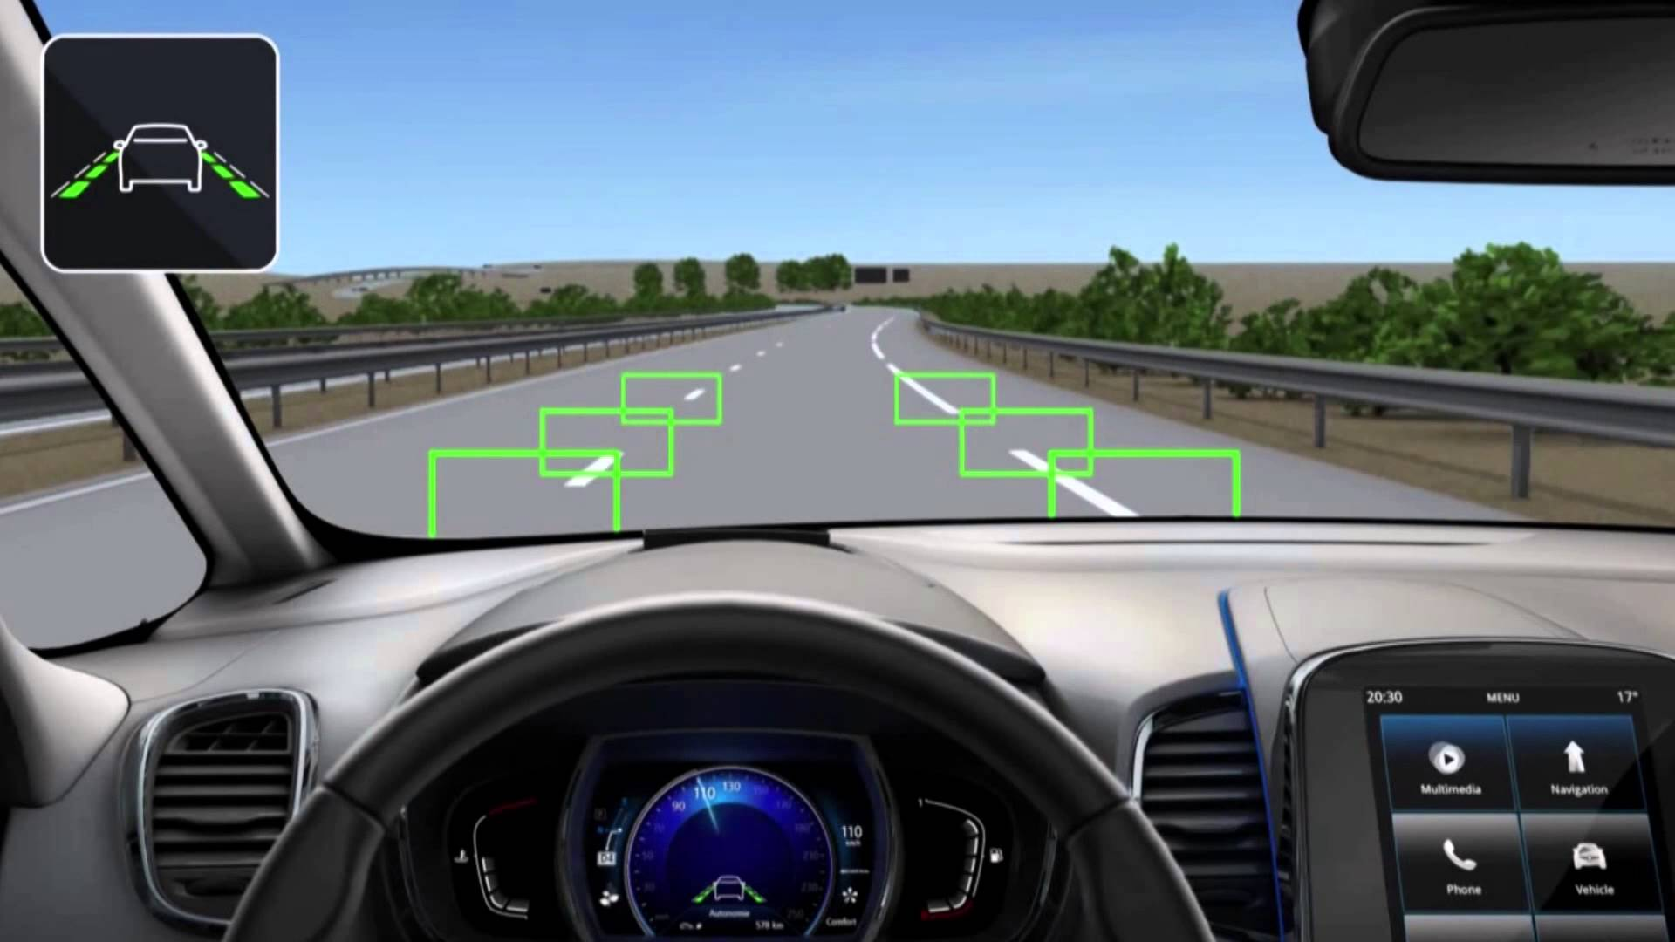

Slide 5
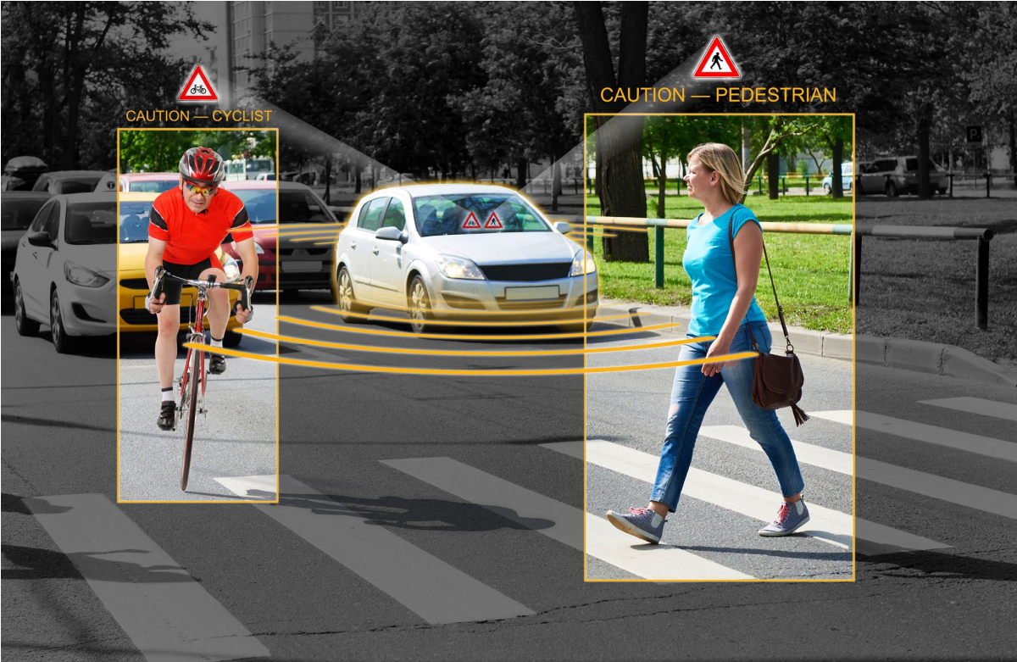

Slide 6


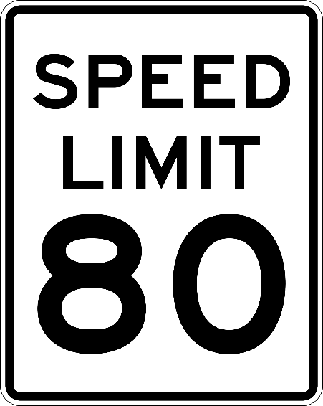




Slide 7
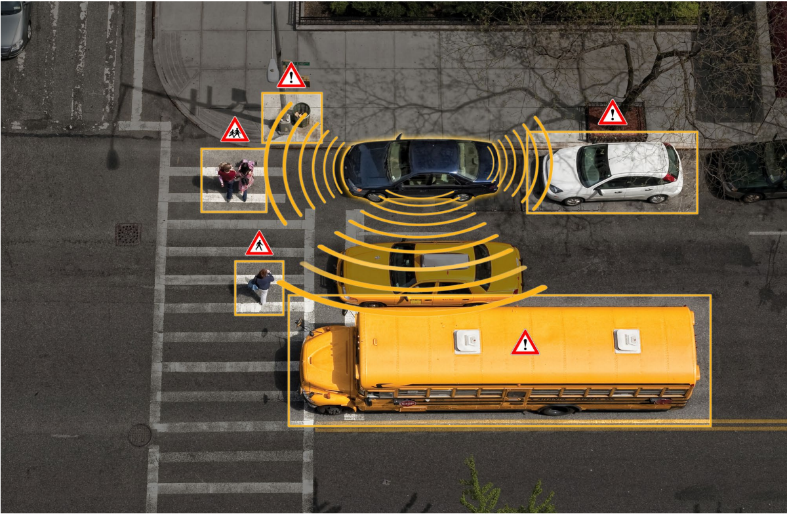
Notes:
Ultra-sound

Slide 8
Image sensor processing

Slide 9
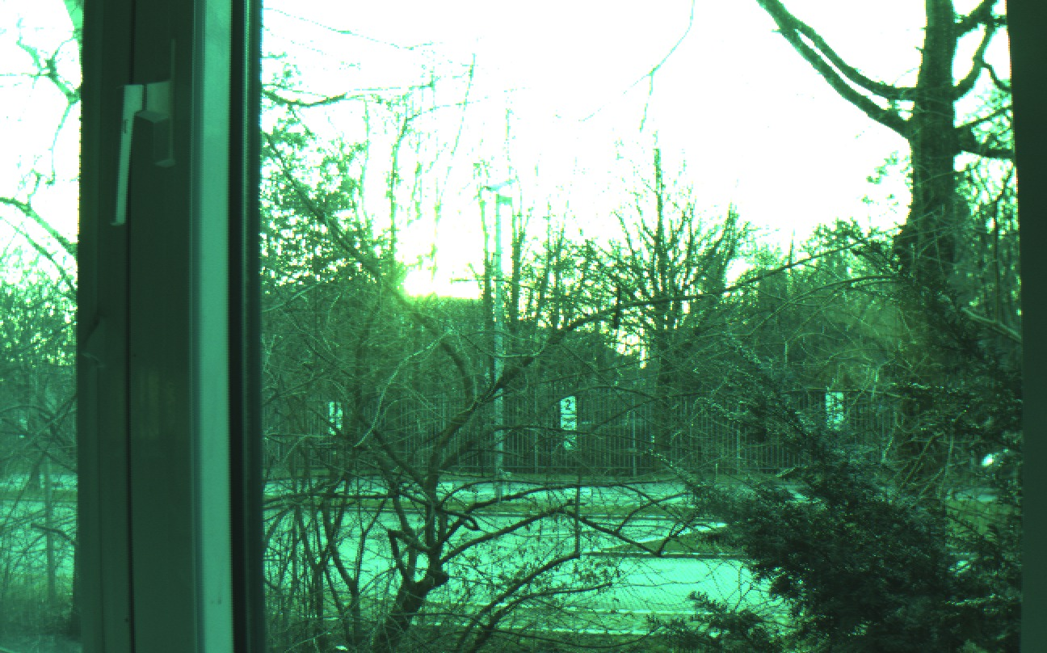
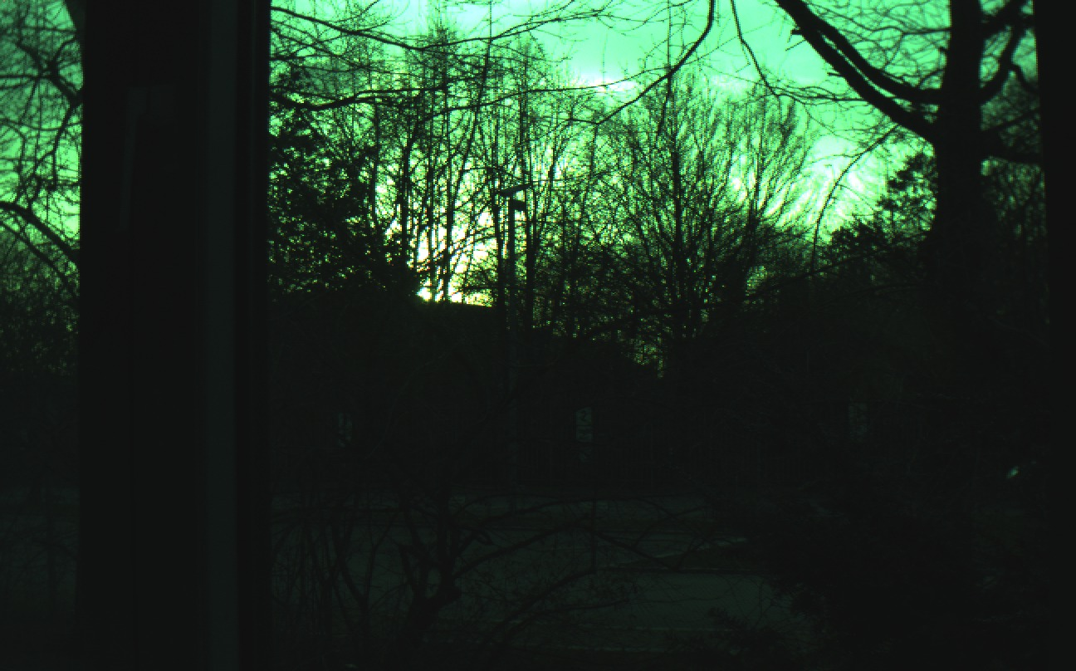
Raw Camera Image

Slide 10
Raw Camera Image
Why does it look greenish?

Slide 11
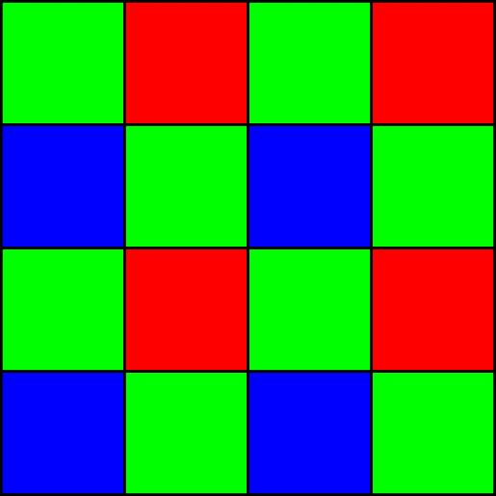
Bayer Pattern

Slide 12
Sensor sensitivity
Sensitivity of blue cells
Sensitivity of green cells
Sensitivity of red cells
Sensitivity
Wavelength (nm)

Slide 13
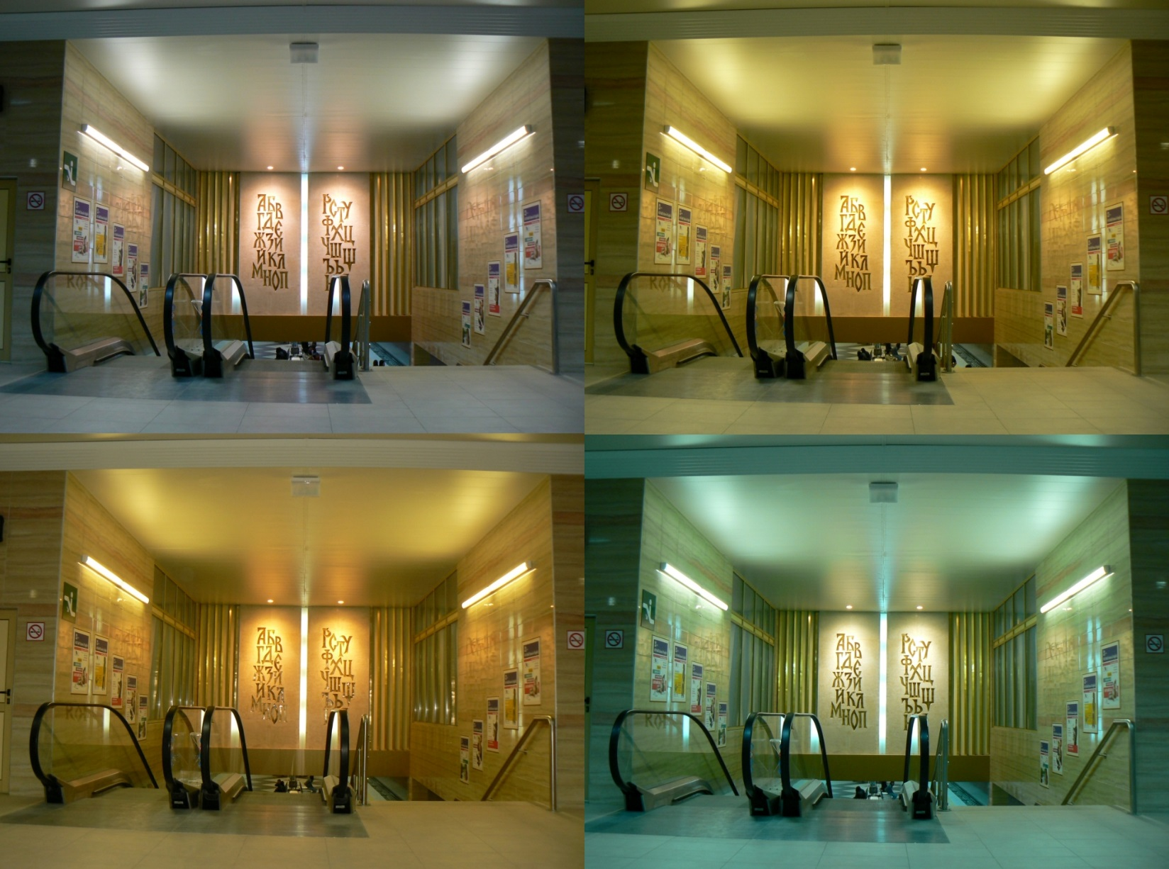
White Balancing

Slide 14
Raw Camera Image
Why is there 2 frames?

Slide 15
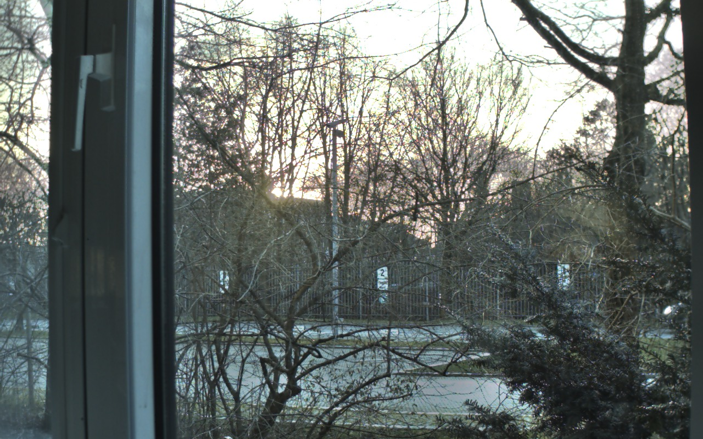
HDR: High Dynamic Range

Slide 16
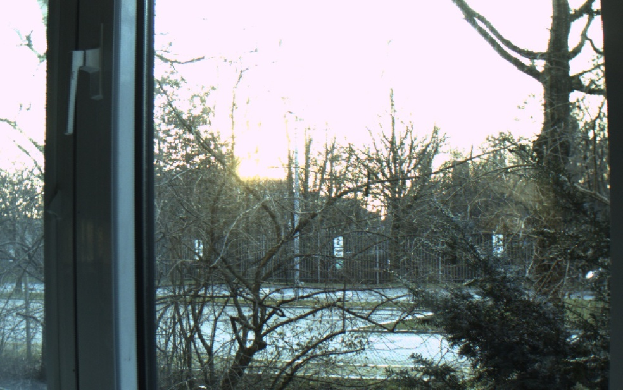
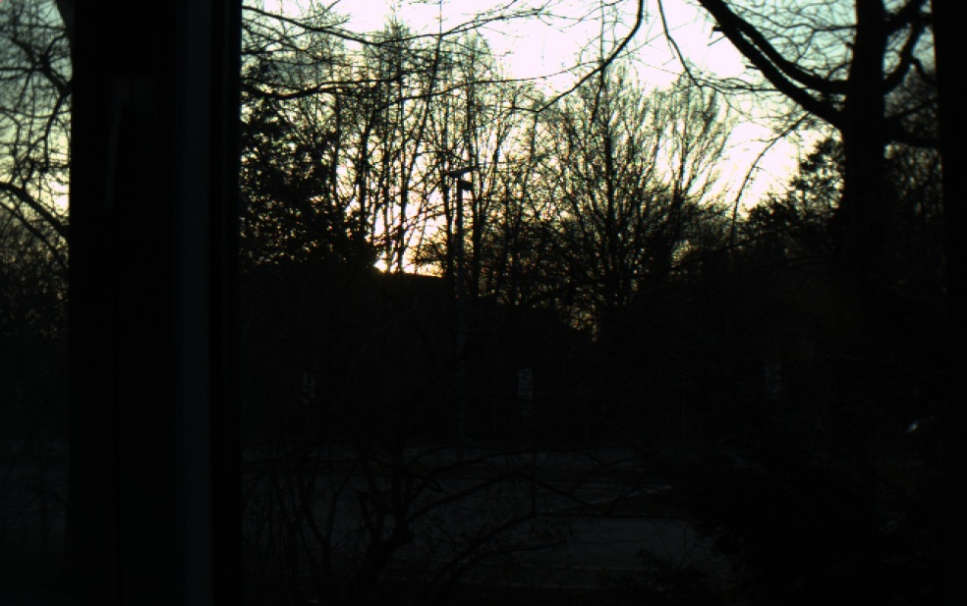
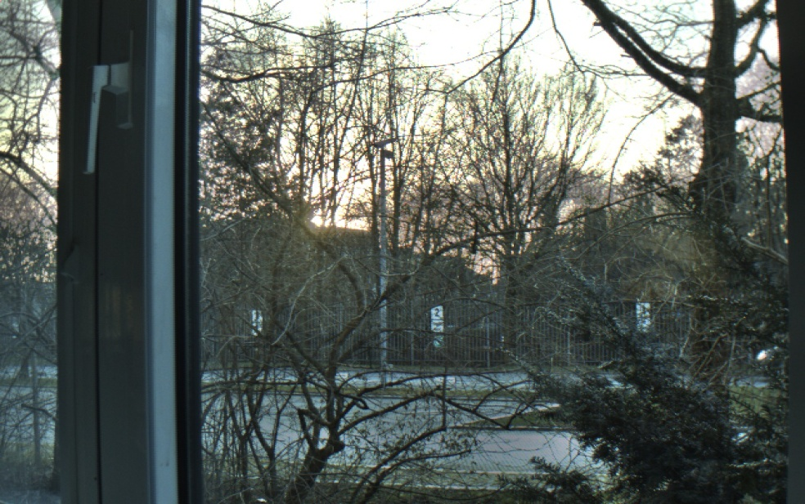
HDR: High Dynamic Range
High exposure
Low exposure
Combination of the 2 exposures

Slide 17
Bayer Pattern
De-bayering
10/12/16b raw data
RGB888 (24b data)

Slide 18
Bayer Pattern
De-bayering (red)
10/12/16b raw data
RGB888 (24b data)

Slide 19
Bayer Pattern
De-bayering (green)
10/12/16b raw data
RGB888 (24b data)

Slide 20
Bayer Pattern
De-bayering (blue)
10/12/16b raw data
RGB888 (24b data)

Slide 21

Vignetting

Slide 22
Image Sensor Processing
Dead pixel
Black level correction
Exposure
White balancing
HDR
Vignetting
De-Bayering
RGB2YUV
Noise Filter
Format Conversion
Full processing for
Up to one 2Mpix camera @ 30fps!
Partial processing for
Up to 4 x 1Mpix cameras @ 30fps

Slide 23
S32v234: Vision Application
Image Pre- Processing
Features Extraction
Features Classification & Prediction
Multi Image Processing
Object Recognition & Fusion
ISP
Corners
Multi-streams connectivity
Adaboost
Tracking, motion estimation
Stitching
Optical flow & disparity
Object recognition/pedestrian
Augmented reality
Face detection
GFX Overlay & Video Distribution
Safe fusion
Graphic overlay & display
2D vs. 3D projection
SVM
Edges
Shapes
Intensity gradients
K-nearest neighbor
CNN
Deep Learning
Image Proc. Platform
CPU Platform
Video & Display Platform
Dual Camera Interfaces
Image Cognition Proc.
Gfx & Display
2 x MIPI CSI2
L-mem
L-mem
Cortex - A53
Cortex - A53
GPU OpenGL ES 3.0
Image Cognition Proc.
32kB I-cache
2 way
32kB D-cache
4 way
32kB I-cache
2 way
32kB D-cache
4 way
Parallel 20 bit
L-mem
L-mem
Cortex - A53
Cortex - A53
DCU 18/24 bits RGB
32 CU
32 CU
32kB I-cache
2 way
32kB D-cache
4 way
32kB I-cache
2 way
32kB D-cache
4 way
Image Signal Processing
32 CU
32 CU
NEON
NEON
Video Codec H.264
Sequencer
DMA
NEON
NEON
8-12 bits Encoder
White Balance & Exposure CTL
HDR/Tone Mapping
De-bayer
Color Conversion
Sequencer
APEX2 CL
DMA
G2-APEX-642
SCU
L2 Cache – 256kB 16 ways
8bit Decoder

Slide 24
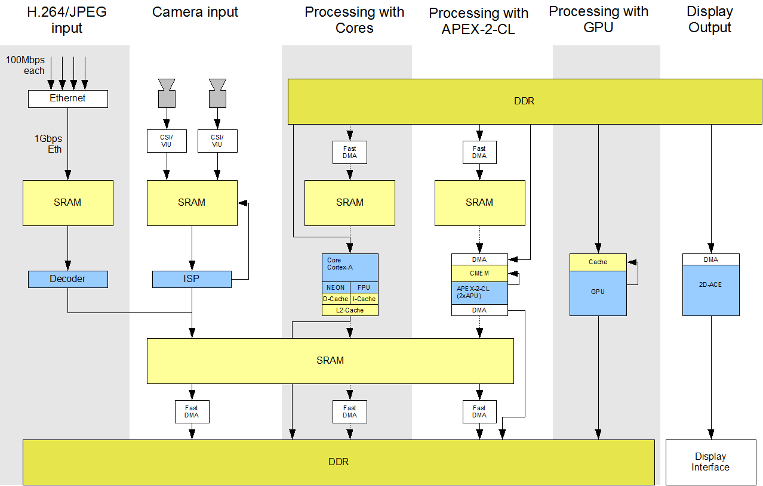
Image Pipeline

Slide 25
Image Pipeline

Slide 26
When to Use the ISP?
Ethernet: ISP is already integrated with the camera
MIPI-CSI & parallel interface:
External ISP required for more than 2Mpix (Internal ISP can be used for further processing)
Internal ISP will save money for mono, stereo cameras and surround view

Slide 27

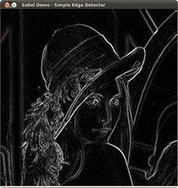
Usage of the ISP
Case 1: Full processing of raw data from camera
Case 2: Additional processing for camera with ISP
Case 3: Prepare image for vision algorithm

Slide 28
AGENDA
The purpose of the ISP
Its architecture
How to program it

Slide 29
AGENDA
The purpose of the ISP
Its architecture
Image processing and ISP kernels
ISP sub-system
ISP graph
Sequencer and processing pipeline
Memory management
IPU
How to program it

Slide 30
Image processing and ISP kernels

Slide 31
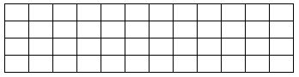
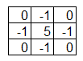
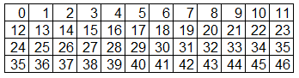
Principle
A matrix used for image convolution for image processing
1 x 0 +
2 x -1 +
3 x 0 +
13 x -1+
14 x 5 +
15 x -1+
25 x 0+
26 x -1+
27 x 0
0 x 0 +
1 x -1 +
2 x 0 +
Result
12 x -1+
13 x 5 +
14 x -1+
13
14
24 x 0+
25 x -1+
26 x 0
Kernel
Image
13
14

Slide 32
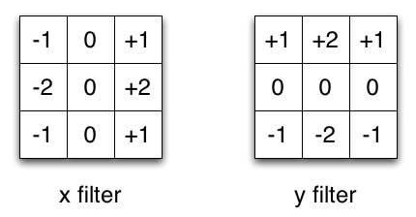
Examples: Sobel
Sobel filtering

Slide 33
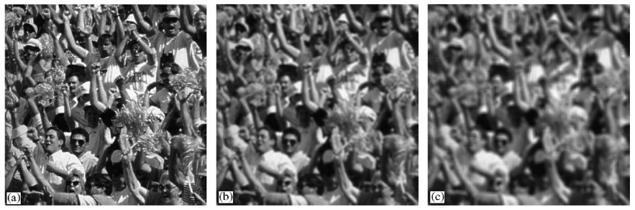
Examples: Mean
1 | 1 | 1 | 1 | 1 | 1 | 1
1 | 1 | 1 | 1 | 1 | 1 | 1
1 | 1 | 1 | 1 | 1 | 1 | 1
1 | 1 | 1 | 1 | 1 | 1 | 1
1 | 1 | 1 | 1 | 1 | 1 | 1
1 | 1 | 1 | 1 | 1 | 1 | 1
1 | 1 | 1 | 1 | 1 | 1 | 1
1/49 *
11
1 | 1 | . | . | 1 | 1
1 | 1 | . | . | 1 | 1
. | . | . | . | . | .
1 | 1 | . | . | 1 | 1
1/121 *
11

Slide 34
ISP Kernel
Can do image convolution
De-Bayering
White balancing
RGB to YUV conversion
…
But It can do much more like:
ISP kernel is a function

Slide 35
ISP kernel
Serialized with other ISP kernels
Kernel1
Kernel 2
Kernel 3

Slide 36


ISP Kernel examples
Kernel1
Kernel2

Slide 37
ISP subsystem

Slide 38
ISP Sub-system
IPU Modules
IPUS_0
IPUS
=
Scalar Image Processing Unit
(one result pixel at a time)
IPUS_1
…
IPUS_7

Slide 39
ISP Sub-system
IPU Modules
IPUS_0
IPUS_1
…
IPUS_7
IPUV_0
IPUV
=
Vector Image Processing Unit
(4 result pixels at a time)
…
IPUV_3

Slide 40
ISP Sub-system
IPU Modules
IPUS_0
Execute the Kernels
IPUS_1
…
IPUS_7
IPUV_0
…
IPUV_3

Slide 41
ISP Sub-system
SRAM
SRAM controller
IPU Modules
IPUS_0
IPUS_1
…
IPUS_7
Each input/output can fetch/output multiple data at the same time
IPUV_0
…
IPUV_3

Slide 42
ISP Sub-system
SRAM
SRAM controller
IPU Modules
IPUS_0
IPUS_1
…
IPUS_7
IPUV_0
…
IPUV_3

Slide 43
ISP Sub-system
SRAM
SRAM controller
IPU Modules
Sequencer
IPUS_0
IPUS_1
…
M0 Core
IPUS_7
IPUV_0
…
IPUV_3

Slide 44
ISP Sub-system
SRAM
SRAM controller
IPU Modules
Sequencer
IPUS_0
IPUS_1
…
M0 Core
IPUS_7
Data/ Instr. RAM
IPUV_0
…
IPUV_3

Slide 45
ISP Sub-system
SRAM
SRAM controller
IPU Modules
Sequencer
Crypto protected
IPUS_0
Kernel RAM
IPUS_1
…
M0 Core
IPUS_7
Data/ Instr. RAM
IPUV_0
…
IPUV_3

Slide 46
ISP Sub-system
SRAM
SRAM controller
IPU Modules
Sequencer
done
IPUS_0
start
Kernel RAM
IPUS_1
…
M0 Core
IPUS_7
Data/ Instr. RAM
IPUV_0
…
IPUV_3
Configuration and synchronization signals

Slide 47
ISP Sub-system
SRAM
SRAM controller
IPU Modules
Sequencer
done
IPUS_0
start
Kernel RAM
IPUS_1
…
M0 Core
IPUS_7
Data/ Instr. RAM
IPUV_0
…
IPUV_3
Fast DMA
DRAM

Slide 48
ISP Sub-system
SRAM
SRAM controller
IPU Modules
Sequencer
done
IPUS_0
start
Kernel RAM
IPUS_1
…
M0 Core
IPUS_7
Data/ Instr. RAM
IPUV_0
…
IPUV_3
done
Fast DMA
start
Configuration and synchronization signals
DRAM

Slide 49
ISP Sub-system
SRAM
SRAM controller
IPU Modules
Sequencer
done
IPUS_0
start
Kernel RAM
IPUS_1
…
M0 Core
IPUS_7
Data/ Instr. RAM
IPUV_0
…
IPUV_3
done
Fast DMA
Programmable Engines
start
DRAM

Slide 50

ISP Sub-system
SRAM
SRAM controller
MIPI-CSI
Camera
IPU Modules
Sequencer
done
IPUS_0
start
Kernel RAM
IPUS_1
…
M0 Core
IPUS_7
Data/ Instr. RAM
IPUV_0
…
IPUV_3
done
Fast DMA
start
DRAM

Slide 51
ISP graph

Slide 52
Graph
Camera Input
Buffer 1
Kernel1
Buffer 2
Kernel 2
…

Slide 53
Graph
Camera Input
Buffer 1
Kernel1
Final SRAM Buffer
DRAM Buffer
…
FAST DMA transfer

Slide 54
ISP Kernel examples
Kernel1
Kernel2

Slide 55
Graph
Buffer 1
Kernel1
Buffer 2

Slide 56
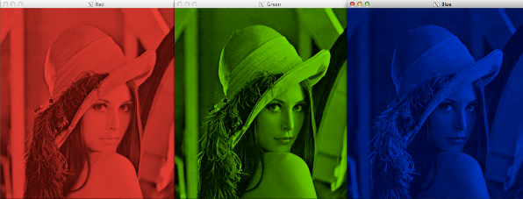
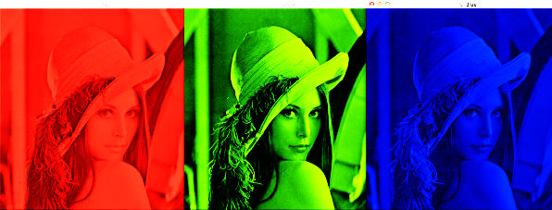
Graph
Buffer 1
Kernel 2
Buffer 2
Kernel1
Buffer 3
Kernel 3
…

Slide 57
Graph
Buffer 1
Kernel 3
…

Slide 58
Graph
Kernel 3
…
Buffer 1
Kernel 4
…

Slide 59
Sequencer and processing pipeline

Slide 60
ISP Sub-system
SRAM
SRAM controller
MIPI-CSI
Camera
IPU Modules
Sequencer
done
IPUS_0
start
Kernel RAM
IPUS_1
…
M0 Core
IPUS_7
Data/ Instr. RAM
IPUV_0
…
IPUV_3
done
Fast DMA
start
DRAM

Slide 61
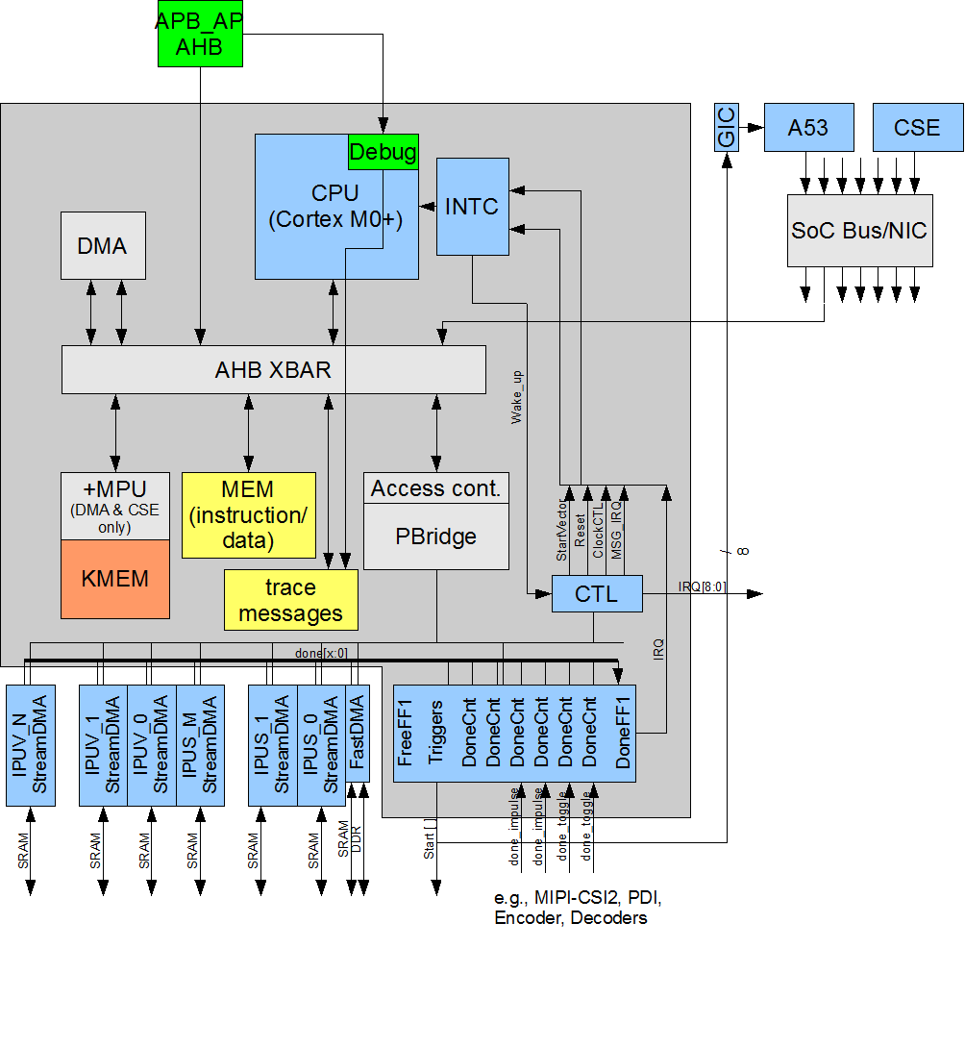
Sequencer: Block Diagram
Mapped into Host address space
Peripherals can also be controlled by Host CPU: IPUs and FastDMA
Servicing the Debug Unit for the IPUs
Executes the graph

Slide 62
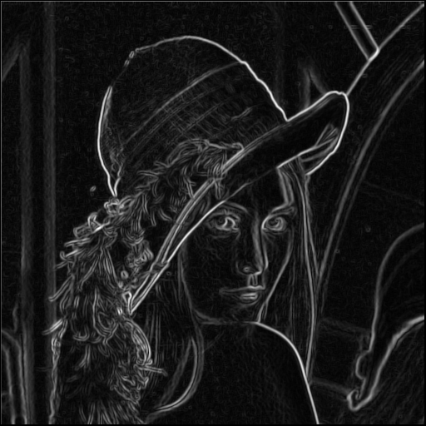
ISP Pipeline
Camera image buffer
Intermediate buffer
Final buffer
Kernel1
Kernel2

Slide 63
ISP Pipeline
Camera image buffer
Intermediate buffer
Final buffer
Kernel1
Kernel2

Slide 64
ISP Pipeline
Final SRAM buffer
Final DRAM buffer
FAST DMA transfer

Slide 65
Memory management

Slide 66
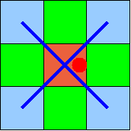
ISP Kernel
A lot of image processing steps (kernels) require multiple lines:
De-bayering
Sobel filtering
IPUs can fetch pixels from different lines

Slide 67
Image processing kernel
0 x 0 +
1 x -1 +
2 x 0 +
Result
12 x -1+
13 x 5 +
14 x -1+
13
24 x 0+
25 x -1+
26 x 0
Kernel
Image
13

Slide 68
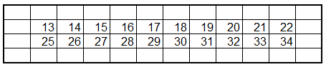
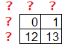
Image processing kernel
Result
Kernel
Image

Slide 69
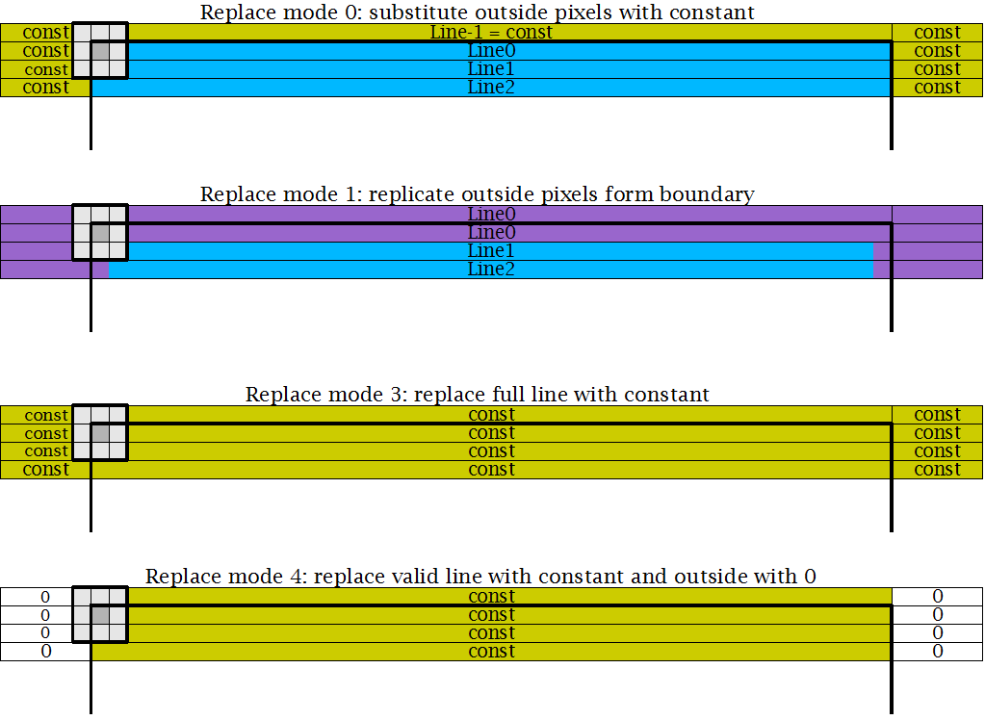
Hardware Replacement Modes
StreamDMA has a lot of additional features:
Scaling
Multiple data format support

Slide 70
IPU

Slide 71
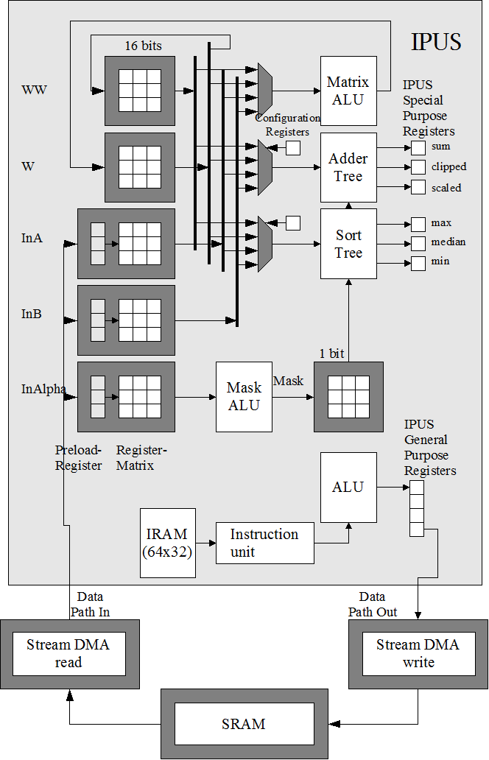
Scalar Engine (IPUS)

Slide 72
Scalar Engine (IPUS)
Input window: 3x3 or 9x1
Up to 3 Inputs:
Ex: R, G, B

Slide 73
Scalar Engine (IPUS)
No data memory (no load/store), only registers
Instruction memory
Decoding unit

Slide 74
Scalar Engine (IPUS)
Matrix ALU (3x3 -> 3x3)
Working matrix

Slide 75
Scalar Engine (IPUS)
3X3 Accelerators:
Sum, scaled, clipped
Max, median, min
Other accelerators:
Histogram
PRNG
Mask matrix: To select on which elements of the matrix the operation or accelerator should be applied to

Slide 76
Scalar Engine (IPUS)
Up to 2 output

Slide 77
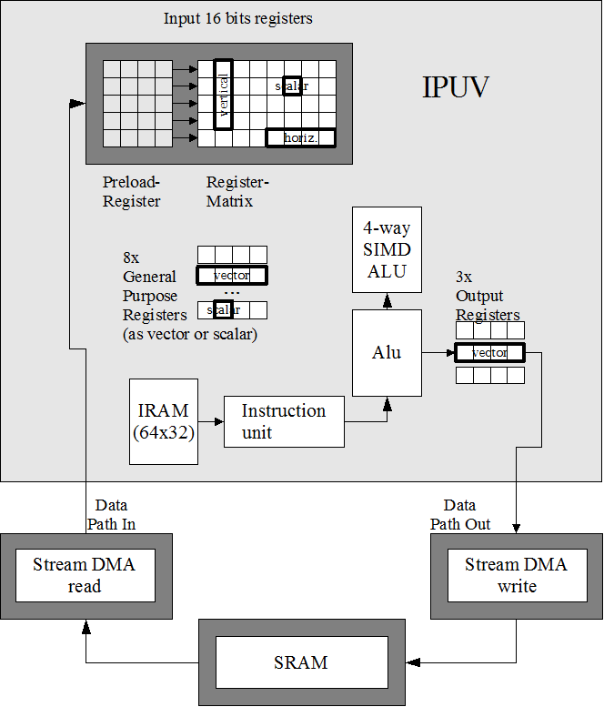
Vector Engine (IPUV)
5x5 input windows
Handles operation with:
Horizontal vectors
Vertical vectors
Scalars
4-way SIMD ALU

Slide 78
IPU Engines
8 x IPUS & 4 x IPUV
500MHz per Engine: 6000MHz total
Pixels are 16-bit fixed point data in signed or unsigned mode
Input and output managed by the StreamDMA engines

Slide 79
Input Matrix: IPUS
In2 | In1 | In0
In4 | In2 | In3
In7 | In6 | In5
3x3
In8 | In7 | In6 | In5 | In4 | In3 | In2 | In1 | In0
9x1

Slide 80
Input Matrix: IPUS
Pix 0 | Pix 1 | Pix 2 | Pix 3 | Pix 4 | Pix 5 | Pix 6 | Pix 7 | Pix 8
Pix 9 | Pix 10 | Pix 11 | Pix 12 | Pix 13 | Pix 14 | Pix 15 | Pix 16 | Pix 17
Pix 18 | Pix 19 | Pix 20 | Pix 21 | Pix 22 | Pix 23 | Pix 24 | Pix 25 | Pix 26
Pix 27 | Pix 28 | Pix 29 | Pix 30 | Pix 31 | Pix 32 | Pix 33 | Pix 34 | Pix 35
Pix 36 | Pix 37 | Pix 38 | Pix 39 | Pix 40 | Pix 41 | Pix 42 | Pix 43 | Pix 44
Pix 45 | Pix 46 | Pix 47 | Pix 48 | Pix 49 | Pix 50 | Pix 51 | Pix 52 | Pix 53
Input image
Input matrix

Slide 81
Input Matrix: IPUS
Pix 0 | Pix 1 | Pix 2 | Pix 3 | Pix 4 | Pix 5 | Pix 6 | Pix 7 | Pix 8
Pix 9 | Pix 10 | Pix 11 | Pix 12 | Pix 13 | Pix 14 | Pix 15 | Pix 16 | Pix 17
Pix 18 | Pix 19 | Pix 20 | Pix 21 | Pix 22 | Pix 23 | Pix 24 | Pix 25 | Pix 26
Pix 27 | Pix 28 | Pix 29 | Pix 30 | Pix 31 | Pix 32 | Pix 33 | Pix 34 | Pix 35
Pix 36 | Pix 37 | Pix 38 | Pix 39 | Pix 40 | Pix 41 | Pix 42 | Pix 43 | Pix 44
Pix 45 | Pix 46 | Pix 47 | Pix 48 | Pix 49 | Pix 50 | Pix 51 | Pix 52 | Pix 53
1st Input

Slide 82
Input Matrix: IPUS
Pix 0 | Pix 1 | Pix 2 | Pix 3 | Pix 4 | Pix 5 | Pix 6 | Pix 7 | Pix 8
Pix 9 | Pix 10 | Pix 11 | Pix 12 | Pix 13 | Pix 14 | Pix 15 | Pix 16 | Pix 17
Pix 18 | Pix 19 | Pix 20 | Pix 21 | Pix 22 | Pix 23 | Pix 24 | Pix 25 | Pix 26
Pix 27 | Pix 28 | Pix 29 | Pix 30 | Pix 31 | Pix 32 | Pix 33 | Pix 34 | Pix 35
Pix 36 | Pix 37 | Pix 38 | Pix 39 | Pix 40 | Pix 41 | Pix 42 | Pix 43 | Pix 44
Pix 45 | Pix 46 | Pix 47 | Pix 48 | Pix 49 | Pix 50 | Pix 51 | Pix 52 | Pix 53
2nd Input

Slide 83
Input Matrix: IPUS
Pix 0 | Pix 1 | Pix 2 | Pix 3 | Pix 4 | Pix 5 | Pix 6 | Pix 7 | Pix 8
Pix 9 | Pix 10 | Pix 11 | Pix 12 | Pix 13 | Pix 14 | Pix 15 | Pix 16 | Pix 17
Pix 18 | Pix 19 | Pix 20 | Pix 21 | Pix 22 | Pix 23 | Pix 24 | Pix 25 | Pix 26
Pix 27 | Pix 28 | Pix 29 | Pix 30 | Pix 31 | Pix 32 | Pix 33 | Pix 34 | Pix 35
Pix 36 | Pix 37 | Pix 38 | Pix 39 | Pix 40 | Pix 41 | Pix 42 | Pix 43 | Pix 44
Pix 45 | Pix 46 | Pix 47 | Pix 48 | Pix 49 | Pix 50 | Pix 51 | Pix 52 | Pix 53
… 5th input

Slide 84
Input Matrix: IPUS
Pix 0 | Pix 1 | Pix 2 | Pix 3 | Pix 4 | Pix 5 | Pix 6 | Pix 7 | Pix 8
Pix 9 | Pix 10 | Pix 11 | Pix 12 | Pix 13 | Pix 14 | Pix 15 | Pix 16 | Pix 17
Pix 18 | Pix 19 | Pix 20 | Pix 21 | Pix 22 | Pix 23 | Pix 24 | Pix 25 | Pix 26
Pix 27 | Pix 28 | Pix 29 | Pix 30 | Pix 31 | Pix 32 | Pix 33 | Pix 34 | Pix 35
Pix 36 | Pix 37 | Pix 38 | Pix 39 | Pix 40 | Pix 41 | Pix 42 | Pix 43 | Pix 44
Pix 45 | Pix 46 | Pix 47 | Pix 48 | Pix 49 | Pix 50 | Pix 51 | Pix 52 | Pix 53
1st Input of the 2nd line

Slide 85
Input Matrix: IPUS
Pix 0 | Pix 1 | Pix 2 | Pix 3 | Pix 4 | Pix 5
Pix 9 | Pix 10 | Pix 11 | Pix 12 | Pix 13 | Pix 14
Pix 18 | Pix 19 | Pix 20 | Pix 21 | Pix 22 | Pix 23
Pix 27 | Pix 28 | Pix 29 | Pix 30 | Pix 31 | Pix 32
Pix 36 | Pix 37 | Pix 38 | Pix 39 | Pix 40 | Pix 41
Pix 45 | Pix 46 | Pix 47 | Pix 48 | Pix 49 | Pix 50
9x1 mode 3rd Input

Slide 86
AGENDA
The purpose of the ISP
Its architecture
How to program it

Slide 87
AGENDA
The purpose of the ISP
Its architecture
How to program it
Graph tool
Kernel example
Software Components
Build Process
Project structure

Slide 88
Graph tool (DEMO)

Slide 89
Kernel example

Slide 90
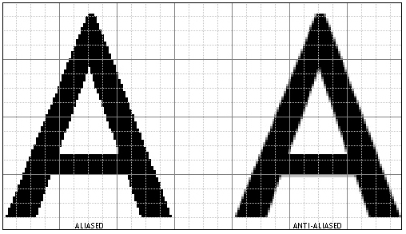
Example of 2:1 Scaling
1 | 2 | 1
2 | 4 | 2
1 | 2 | 1
x 1/16
3x3 Gaussian filter
Low pass filter
Aliased
Anti-aliased

Slide 91
Example of 2:1 Scaling
1 | 2 | 1
2 | 4 | 2
1 | 2 | 1
1/16 | 1/8 | 1/16
1/8 | 1/4 | 1/8
1/16 | 1/8 | 1/16
1/16 equivalent to a right shift of 4
1/8 equivalent to a right shift of 3
1/4 equivalent to a right shift of 2
x 1/16
4 | 3 | 4
3 | 2 | 3
4 | 3 | 4
Shift Matrix:

Slide 92
Example of 2:1 Scaling
Code: IPU configuration
start_scale:
mov confalu, (0 /*unsigned*/ |
(1<<1) /*saturate*/)
mov confaddt,(0 /*w*/ |
(0<<3) /*unsigned*/ |
(5<<5) /*shift*/ |
(0x40 << 9) /* scale*/)
Confalu and Confaddt are core registers of the IPU

Slide 93
Example of 2:1 Scaling
 |  | Pix 1,1
 |  | Pix 2,1
 |  | Pix 3,1
Code: Input initialisation
Input matrix
InA
done d0,i
d0:
done d1,i
d1:
done d2,i
 | Pix 1,1 | Pix 1,2
 | Pix 2,1 | Pix 2,2
 | Pix 3,1 | Pix 3,2
Pix 1,1 | Pix 1,2 | Pix 1,3
Pix 2,1 | Pix 2,2 | Pix 2,3
Pix 3,1 | Pix 3,2 | Pix 3,3

Slide 94
Example of 2:1 Scaling
1 | 0 | 1
0 | 0 | 0
1 | 0 | 1
Code: Shifting matrix initialisation
Mask Matrix
d2:
mset 0b101000101
mov w,4 // to w
mset 0b010101010
mov w,3 // to w
mov w4,2

Slide 95
Example of 2:1 Scaling
Mask matrix

Slide 96
Example of 2:1 Scaling
1 | 0 | 1
0 | 0 | 0
1 | 0 | 1
Code: Shifting matrix initialisation
Mask matrix
d2:
mset 0b101000101
mov w,4
mset 0b010101010
mov w,3
mov w4,2
Matrix instruction
4 | 0 | 4
0 | 0 | 0
4 | 0 | 4
Working matrix W

Slide 97
Example of 2:1 Scaling
Working matrix W

Slide 98
Example of 2:1 Scaling
0 | 1 | 0
1 | 0 | 1
0 | 1 | 0
Code: Shifting matrix initialisation
Mask matrix
d2:
mset 0b101000101
mov w,4
mset 0b010101010
mov w,3
mov w4,2
4 | 3 | 4
3 | 0 | 3
4 | 3 | 4
Working matrix W

Slide 99
Example of 2:1 Scaling
Code: Shifting matrix initialisation
d2:
mset 0b101000101
mov w,4
mset 0b010101010
mov w,3
mov w4,2
4 | 3 | 4
3 | 2 | 3
4 | 3 | 4
Working matrix W
Scalar instruction
(Mask matrix does not apply)

Slide 100
Example of 2:1 Scaling
4 | 3 | 4
3 | 2 | 3
4 | 3 | 4
Code: Shifting matrix initialisation
Shift matrix saved in Working matrix WW
swp // w -> ww
mset 0b111111111
(important for future instruction)
1 | 1 | 1
1 | 1 | 1
1 | 1 | 1
Mask matrix

Slide 101
Example of 2:1 Scaling

Slide 102
Example of 2:1 Scaling
to Add all the W elements together and put it in output
+ Fetch new entry
Code: Main Loop
loop:
lsr w,ina,ww
dout sum,odd,ixo
odd:
done loop,ix
end_scale:
Arithmetic-shift-right InA elements according to the coefficient in WW => result saved in W
“sum” register has the sum of all elements of the W matrix. Move that value to out0, and progress to next pixel (input, xpos, output)
Fetch new entry without creating any output: scaling of 2:1
Continue the loop
The kernel will restart from the beginning for each new line

Slide 103
Software Components

Slide 104
ISP Application
ARM Application for Linux or Standalone
ISP libraries
ISP
GDT Compiler
ISP Graph
ARM Code
main()
Compiler (AARCH64 – Linux, SA)
Compiler (AARCH64 – Linux, SA)
IPU Compiler
IPU Kernels
Support libraries
Device drivers
Final APP
3rd party libraries

Slide 105
ISP Application
ARM Application for Linux or Standalone
ISP libraries
ISP
GDT Compiler
ISP Graph
ARM Code
main()
Compiler (AARCH64 – Linux, SA)
Compiler (AARCH64 – Linux, SA)
IPU Compiler
IPU Kernels
Support libraries
Modified by the user
Device drivers
Final APP
3rd party libraries

Slide 106
Build Process

Slide 107
ISP Application
ARM Application for Linux or Standalone
ISP libraries
ISP
GDT Compiler
ISP Graph
ARM Code
main()
Compiler (AARCH64 – Linux, SA)
Compiler (AARCH64 – Linux, SA)
IPU Compiler
IPU Kernels
Support libraries
Device drivers
Final APP
3rd party libraries

Slide 108
Build sequence
Graph defined via graph design tool
ARM Application for Linux or Standalone
ISP libraries
ISP
GDT Compiler
ISP Graph
ARM Code
main()
Compiler (AARCH64 – Linux, SA)
Compiler (AARCH64 – Linux, SA)
IPU Compiler
IPU Kernels
Support libraries
Device drivers
Final APP
3rd party libraries

Slide 109
Build sequence
Graph compiled via GDT compiler -> .h and .c output
ARM Application for Linux or Standalone
ISP libraries
ISP
GDT Compiler
ISP Graph
ARM Code
main()
Compiler (AARCH64 – Linux, SA)
Compiler (AARCH64 – Linux, SA)
IPU Compiler
IPU Kernels
Support libraries
Device drivers
Final APP
3rd party libraries

Slide 110
Build sequence
ARM Application for Linux or Standalone
ISP libraries
ISP
GDT Compiler
ISP Graph
ARM Code
main()
Compiler (AARCH64 – Linux, SA)
Compiler (AARCH64 – Linux, SA)
IPU Compiler
IPU Kernels
Support libraries
Device drivers
IPU Kernels defined in assembly (.s file)
Final APP
3rd party libraries

Slide 111
Build sequence
ARM Application for Linux or Standalone
ISP libraries
ISP
GDT Compiler
ISP Graph
ARM Code
main()
Compiler (AARCH64 – Linux, SA)
Compiler (AARCH64 – Linux, SA)
IPU Compiler
IPU Kernels
Support libraries
Device drivers
IPU Kernels compiled - .c and .h file output
Final APP
3rd party libraries

Slide 112
Build sequence
ARM Application for Linux or Standalone
ISP libraries
ISP
GDT Compiler
ISP Graph
ARM Code
main()
Compiler (AARCH64 – Linux, SA)
Compiler (AARCH64 – Linux, SA)
IPU Compiler
IPU Kernels
Support libraries
Device drivers
Graph compiled and wrapped to C++ - .h and .a file output
Final APP
3rd party libraries

Slide 113
Build sequence
ARM Application for Linux or Standalone
ISP libraries
ISP
GDT Compiler
ISP Graph
ARM Code
main()
Compiler (AARCH64 – Linux, SA)
Compiler (AARCH64 – Linux, SA)
IPU Compiler
IPU Kernels
Support libraries
Device drivers
ISP header is included to ARM application code.
Final APP
3rd party libraries

Slide 114
Build sequence
ARM Application for Linux or Standalone
ISP libraries
ISP
GDT Compiler
ISP Graph
ARM Code
main()
Compiler (AARCH64 – Linux, SA)
Compiler (AARCH64 – Linux, SA)
IPU Compiler
IPU Kernels
Support libraries
Device drivers
Arm application is built and linked together with all the drivers, libs etc.
Final APP
3rd party libraries

Slide 115
Build sequence
ARM Application for Linux or Standalone
ISP libraries
ISP
GDT Compiler
ISP Graph
ARM Code
main()
Compiler (AARCH64 – Linux, SA)
Compiler (AARCH64 – Linux, SA)
IPU Compiler
IPU Kernels
Support libraries
Device drivers
Final application .elfs output
Final APP
3rd party libraries

Slide 116
Project structure

Slide 117
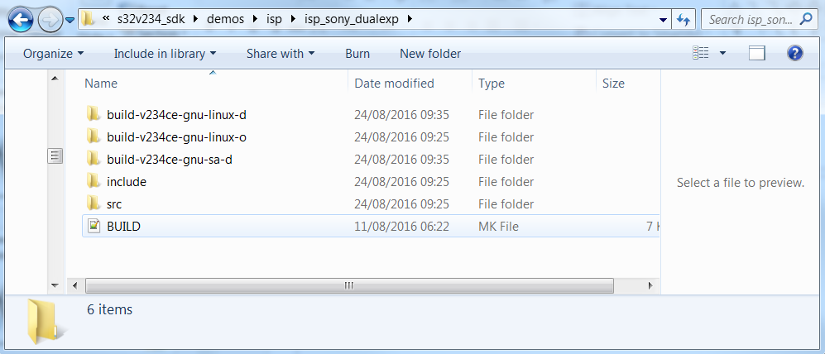
ISP demo
ISP demo can be found in: /s32v234_sdk/demos/isp folder
Demo can be built for stand-alone and Linux environment

Slide 118
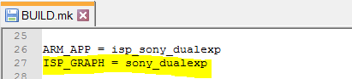
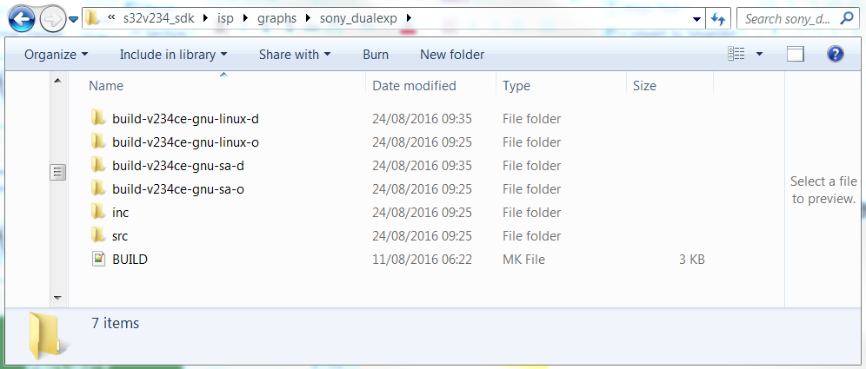
ISP demo
The ISP graph used by the demo is defined in the BUILD.mk file in the project folder
Then the graph can be found in the folder /s32v234_sdk/isp/graphs

Slide 119
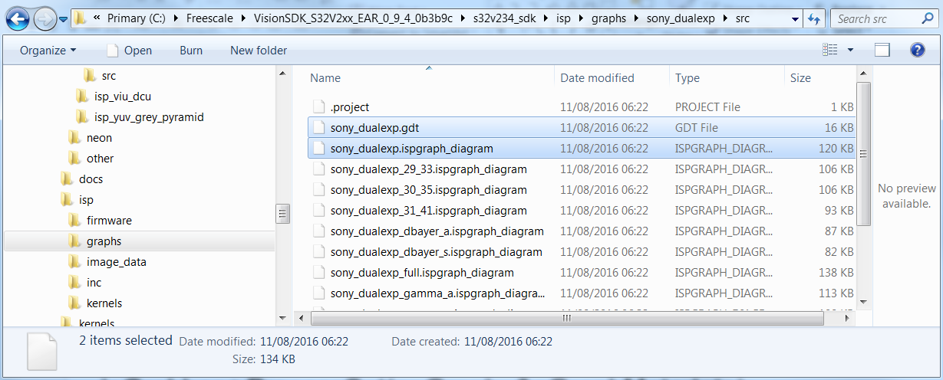
ISP graph
In the graph sources you can find the:
.ispgraph_diagram:
Graph created with the graph tool
As Many as you want
.gdt: descripton file generated by the tool and used by the gdt compiler
Generated based on the “ispgraph_diagram” with the same name as the graph folder

Slide 120
ISP graph
Graph compiled via GDT compiler -> .h and .c output
ARM Application for Linux or Standalone
ISP libraries
ISP
GDT Compiler
ISP Graph
ARM Code
main()
Compiler (AARCH64 – Linux, SA)
Compiler (AARCH64 – Linux, SA)
IPU Compiler
IPU Kernels
Support libraries
Device drivers
Final APP
3rd party libraries

Slide 121
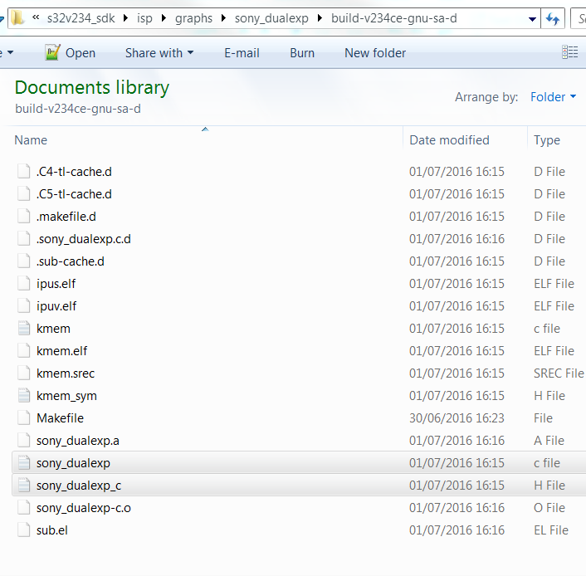
ISP Graph

Slide 122
ISP API
Allocation DRAM buffers for FastDMA transfer
Initialise camera
Start ISP sequencer
Get the output frames of the ISP (for APEX processing, display,…)
Stop ISP sequencer
Read/Write ISP registers

Slide 123
ISP API: Initialisation (main.cpp)
// *** Initialize SDI ***
lRes = sdi::Initialize(0);
// *** create grabber ***
sdi_grabber *lpGrabber = new(sdi_grabber);
lpGrabber->ProcessSet(gpGraph, &gGraphMetadata);
// *** prepare IOs ***
sdi_FdmaIO *lpFdma = (sdi_FdmaIO*)lpGrabber->IoGet(SEQ_OTHRIX_FDMA);

Slide 124
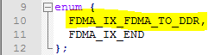
ISP API: Initialisation (main.cpp)
// modify DDR frame geometry to fit display output
GDI_ImageDescriptor lFrmDesc = GDI_ImageDescriptor(SCR_WIDTH, NUM_OUT_LINES >> MULTITRIGGER, YUV422Stream_UYVY);
lpFdma->DdrBufferDescSet(FDMA_IX_FDMA_TO_DDR, lFrmDesc);
//*** allocate DDR buffers ***
lpFdma->DdrBuffersAlloc(FDMA_IX_FDMA_TO_DDR, DDR_OUT_BUFFER_CNT);
List of the FastDMA transfers declared in the header file generated from the graph

Slide 125
ISP API: Initialisation (main.cpp)
// *** prestart grabber ***
lpGrabber->PreStart();
// *** configure camera parameters ***
CamConfig();

Slide 126
ISP API: Run time (main.cpp)
gFrameIsp = lpGrabber->FramePop();
if(gFrameIsp.mImage.mData == NULL)
{
break;
} // if pop failed
When the processing of the frame is over, the buffer needs to be released:
if(lpGrabber->FramePush(gFrameIsp) != LIB_SUCCESS)
{
break;
} // if push failed

Slide 127
ISP API: Run time (main.cpp)
Write into IPU registers:
// black level correction
seq_setReg(CHGAIN_ENGINE, 0, 0x70, 0xa18); // GPR0 (IPUS): R
seq_setReg(CHGAIN_ENGINE, 0, 0x71, 0xa18); // GPR1 (IPUS): GR
seq_setReg(CHGAIN_ENGINE, 0, 0x72, 0xa18); // GPR2 (IPUS): GB
seq_setReg(CHGAIN_ENGINE, 0, 0x73, 0xa18); // GPR3 (IPUS): B

Slide 128
Application code: camera configuration
Initial configuration of the camera (via I2C or SPI)
Measurements
Control/re-configuration during run-time

Slide 129
Questions

Slide 130
For next training session
Install the graph tool
Read Me document: s32v234_sdk\docs\vsdk\ISP_VGS_Installation_Readme
Be able to compile an ISP demo from the VSDK 0.9.4 (compiler and environment ready)
Be able to execute a VSDK example on target (linux or stand-alone environment): EVB and Sony camera

